Slide 1
COMPARATIVES AND SUPERLATIVES

Slide 2
A B C
big
A / C
A is as big as C.
C / B
C is not as big as B.

Slide 3
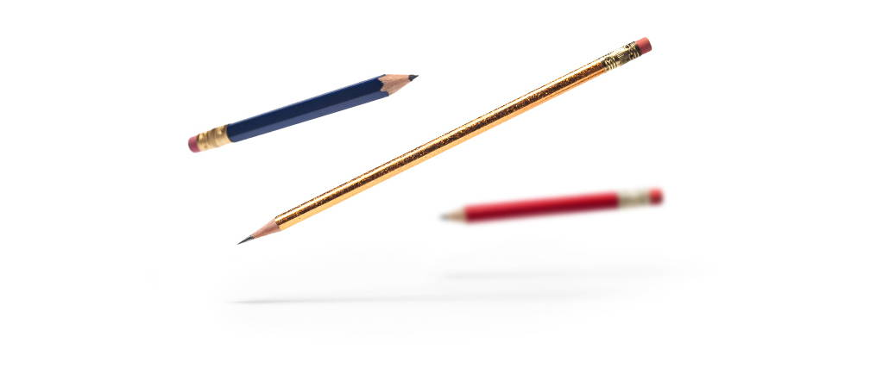
long
blue /red
The blue pencil is as long as the red pencil.
blue/graphite
The red pencil is not as long as the graphite pencil.

Slide 4
The blue pencil is as long as the red pencil.
as + adjective + as
The red pencil is not as long as the graphite pencil.
not as + adjective + as

Slide 5
Comparative Form

Slide 6
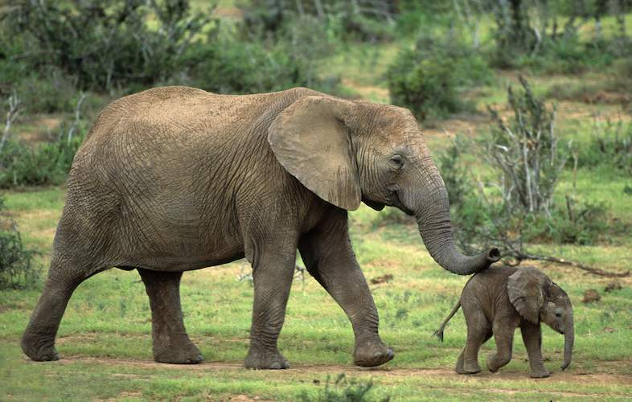

Slide 7
tall
short
large
safe
big
hot
happy
sunny
dangerous
difficult
taller
shorter
larger
safer
bigger
hotter
happier
sunnier
more dangerous
more difficult

Slide 8
IRREGULAR FORMS
good
bad
far
many / much
little
better
worse
farther / further
more
less

Slide 9

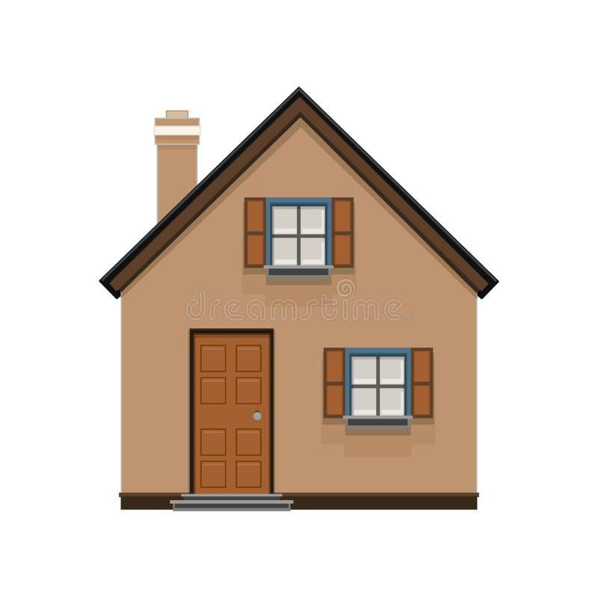
The red house is bigger than the brown house. comparative adjective + than

Slide 10
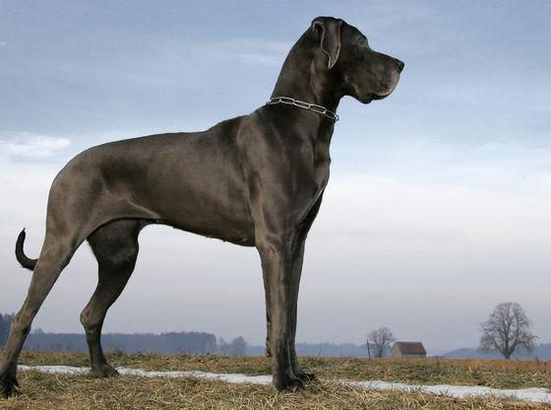
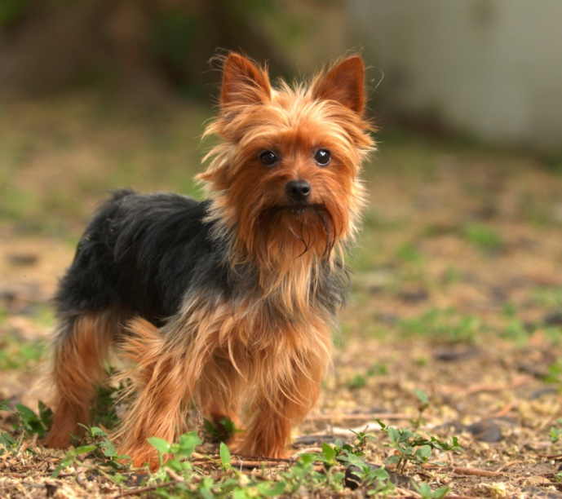
big, small
The black dog is bigger than the brown dog.
The brown dog is smaller than the black dog.

Slide 11
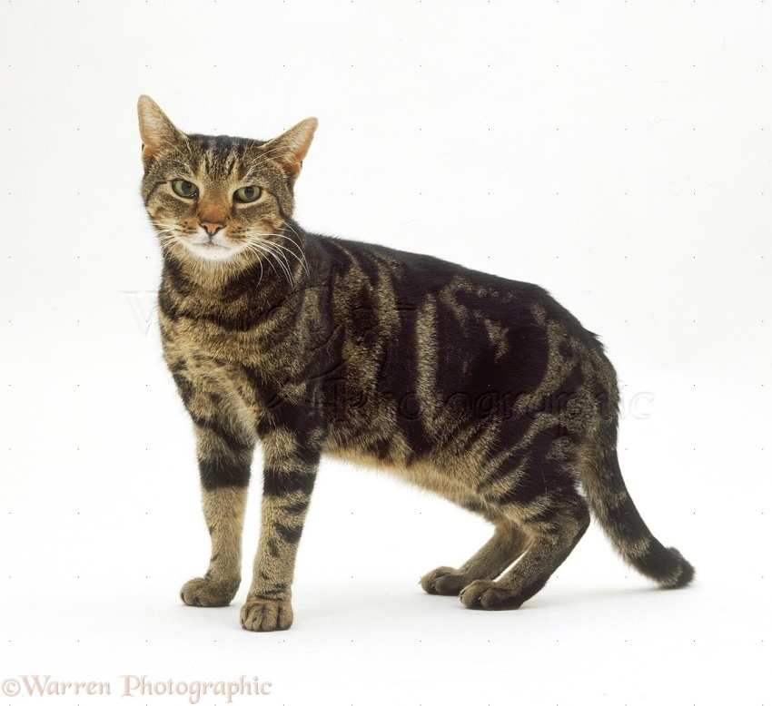
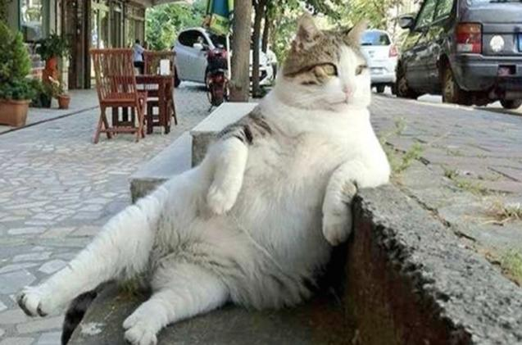
fat, thin
The white cat is fatter than the brown cat.
The brown cat is thinner than the white cat.

Slide 12
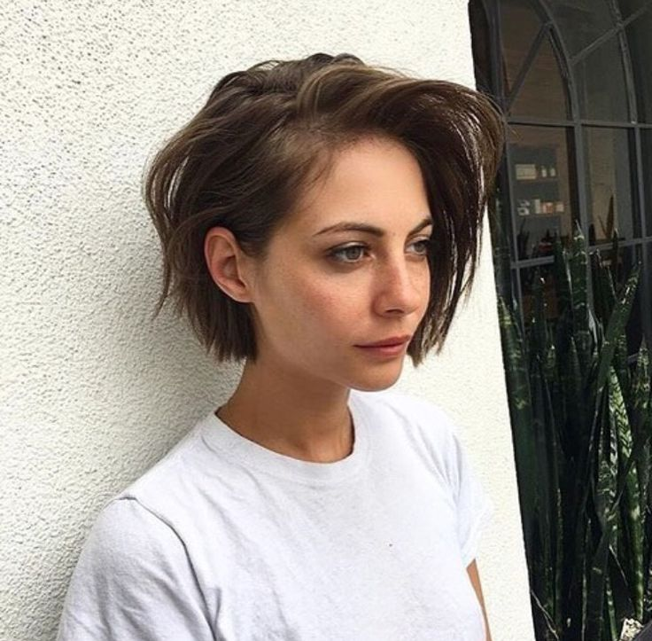
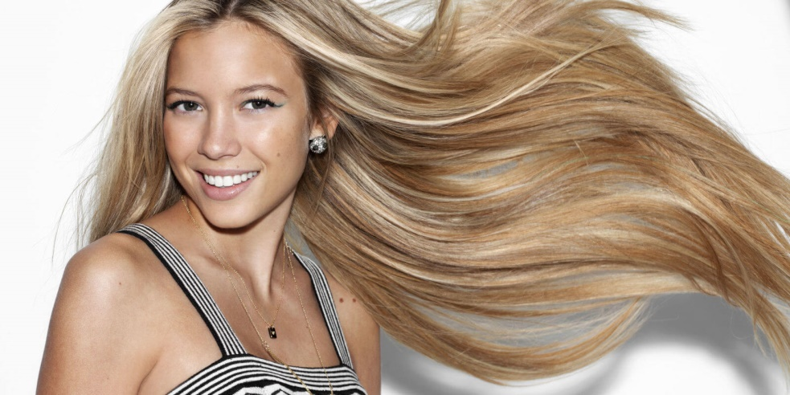
long, short
The blond hair is longer than the brown one.
The brown hair is shorter than the blond one.

Slide 13
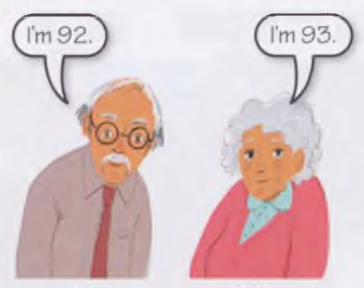

Slide 14
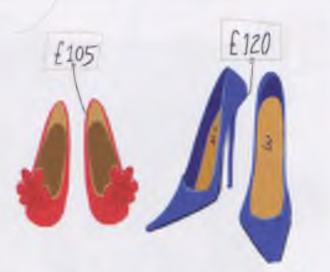

Slide 15
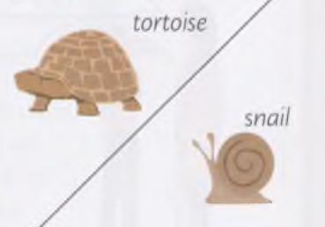

Slide 16
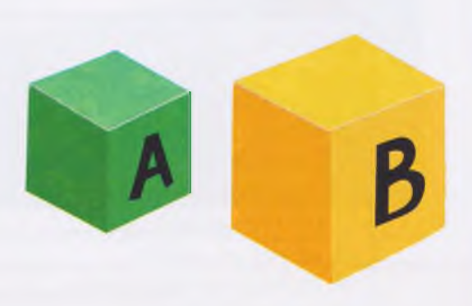

Slide 17
Superlative Form

Slide 18
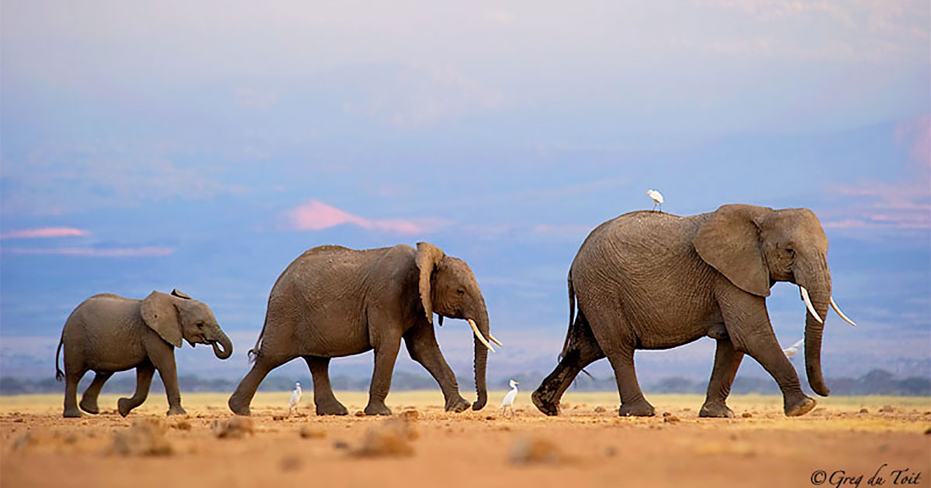

Slide 19
Superlative Form
tall - taller
large - larger
big - bigger
happy - happier
dangerous – more
dangerous
the tallest
the largest
the biggest
the happiest
the most dangerous

Slide 20
IRREGULAR FORMS
good - better
bad - worse
far – farther/further
many/much - more
little - less
the best
the worst
the farthest/furthest
the most
the least

Slide 21
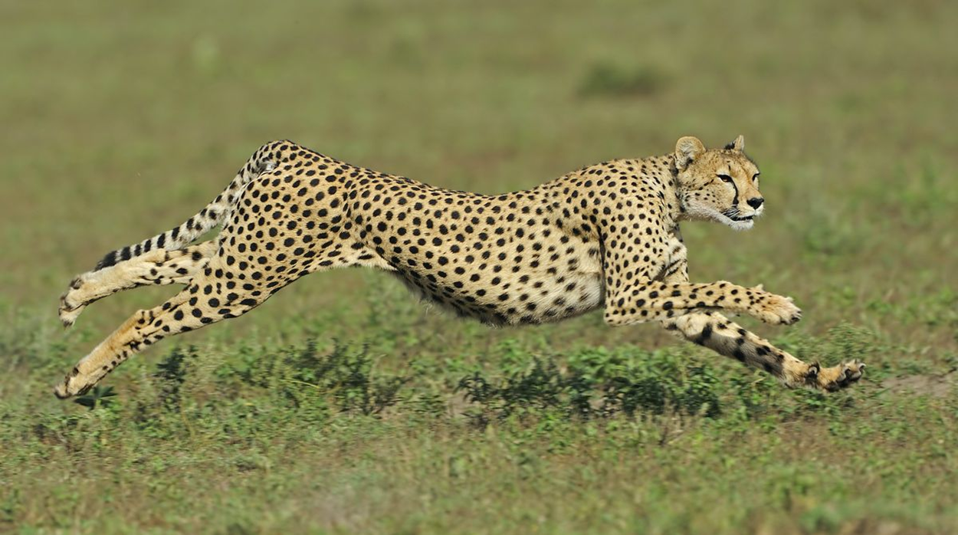
fast
The cheetah is the fastest animal in the world.

Slide 22
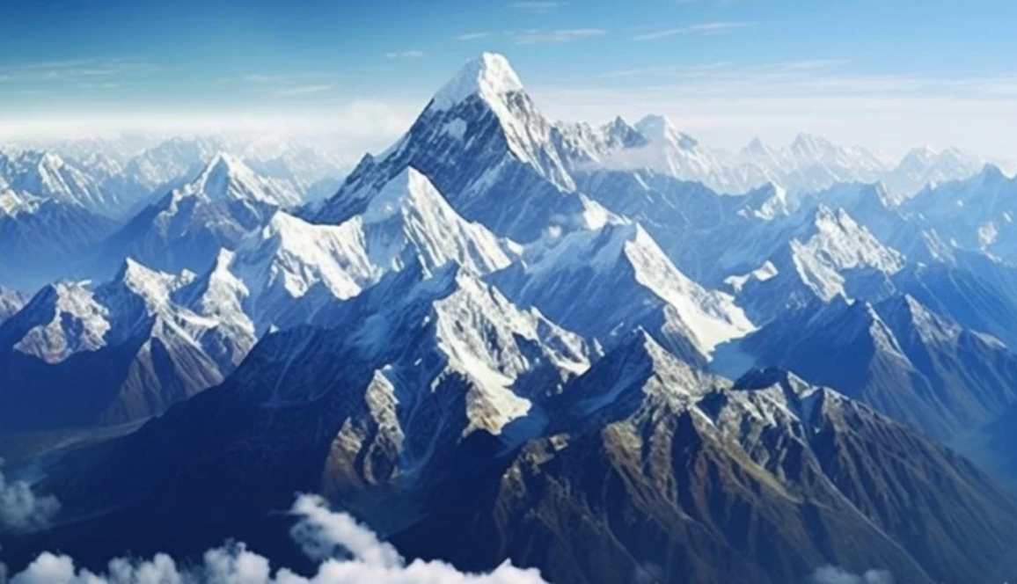
high
Mount Everest is the highest mountain in the world.

Slide 23
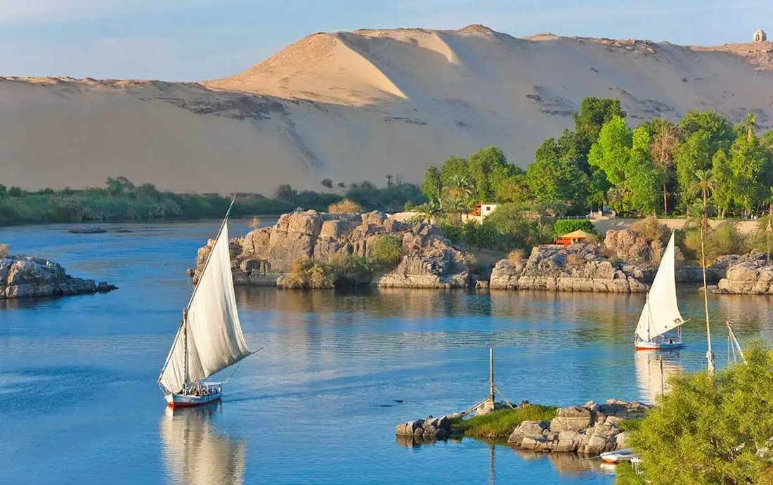
long
The River Nile is the longest river in the world.

Slide 24
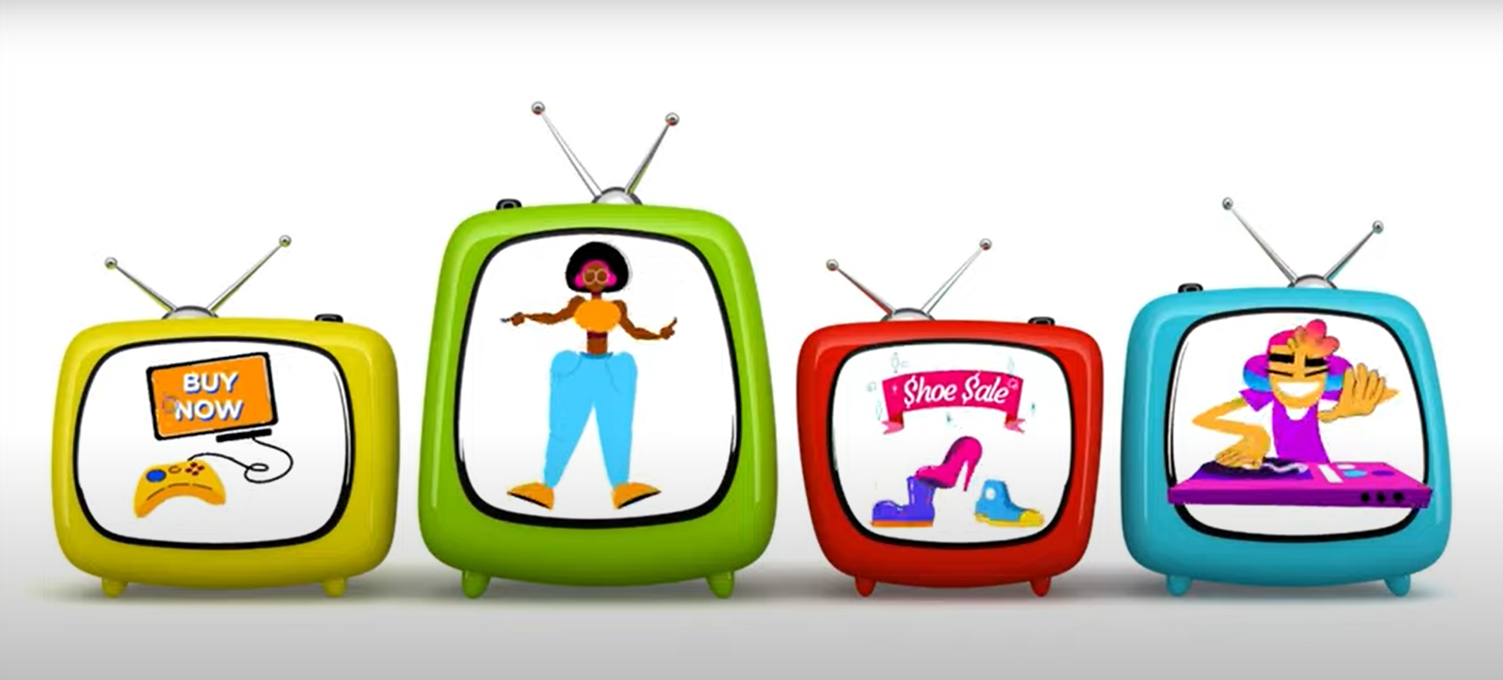
The green TV is the biggest of the four / of all.

Slide 25
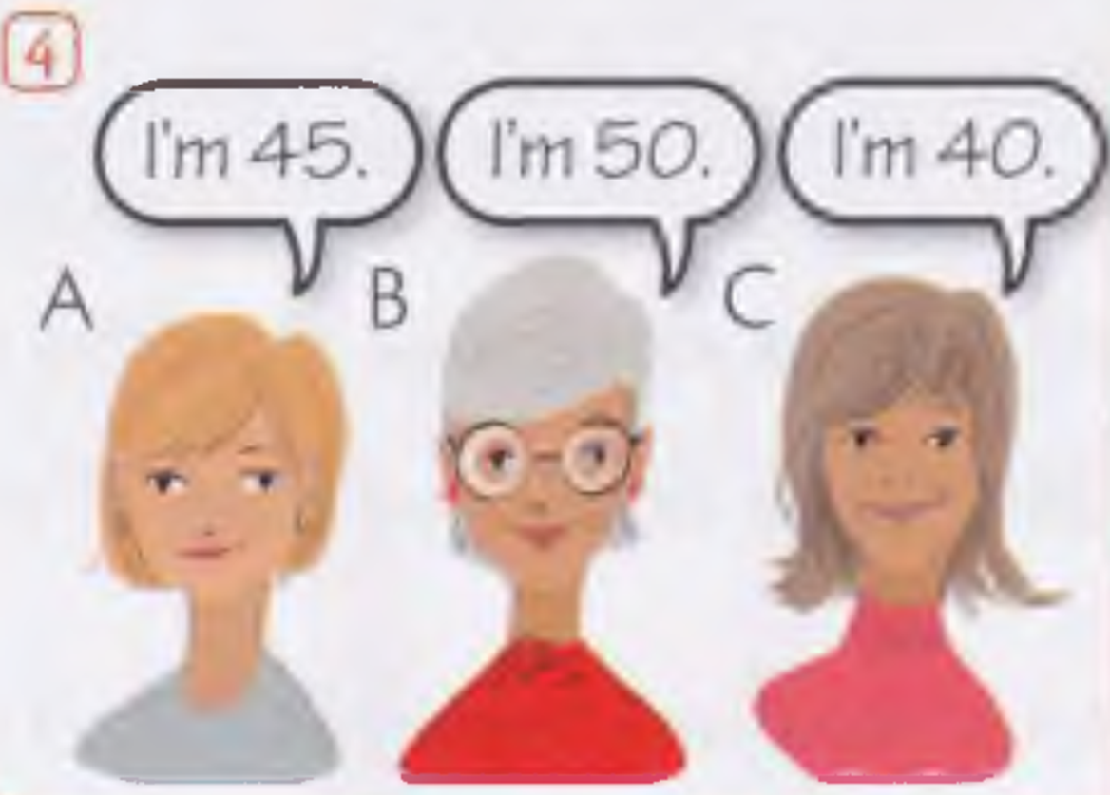

Slide 26
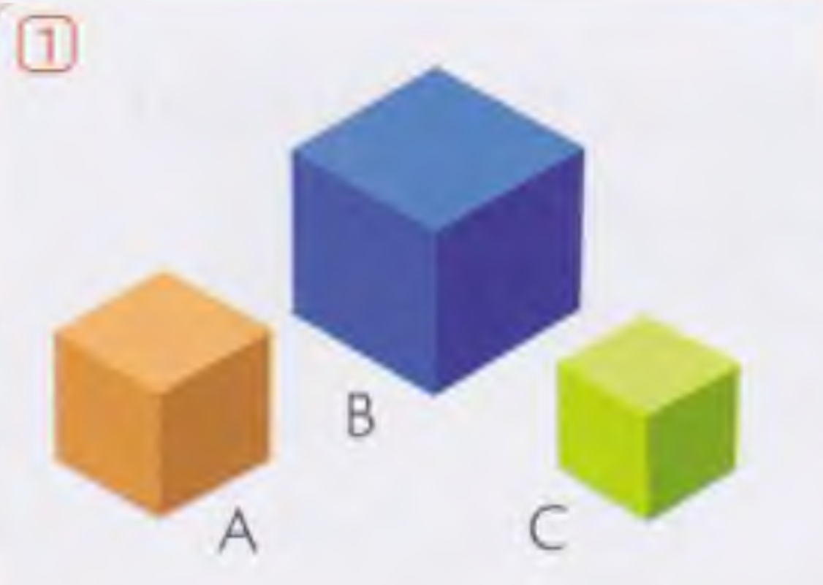

Slide 27
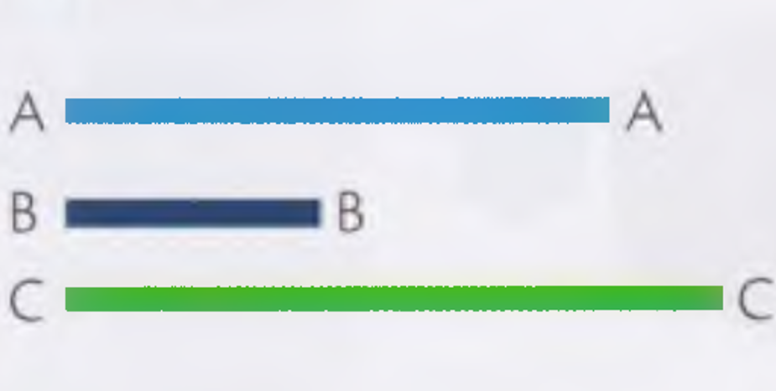

Slide 28
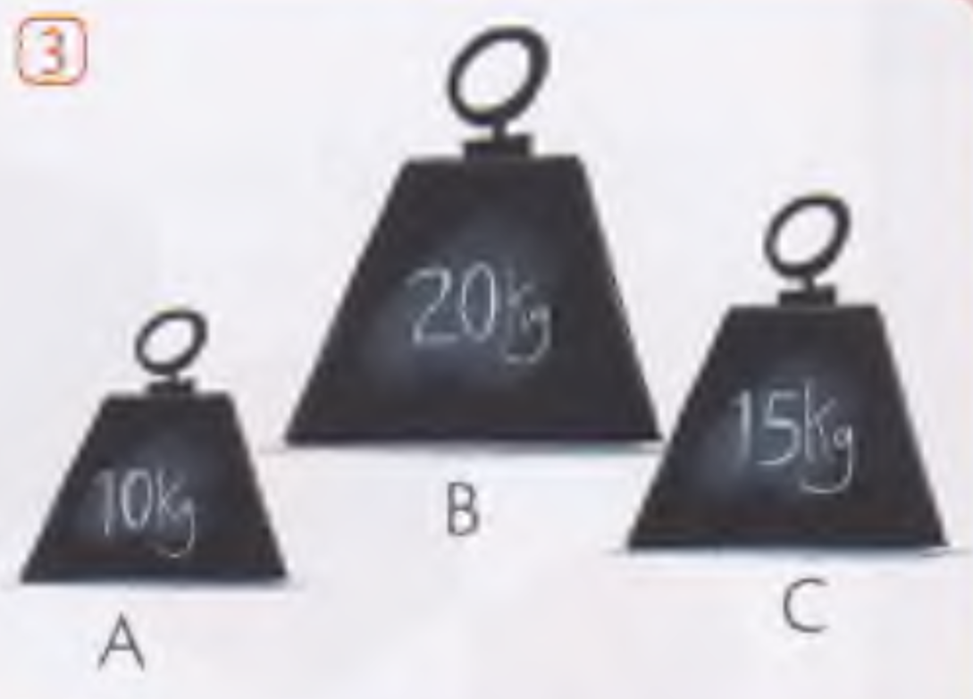

Slide 29
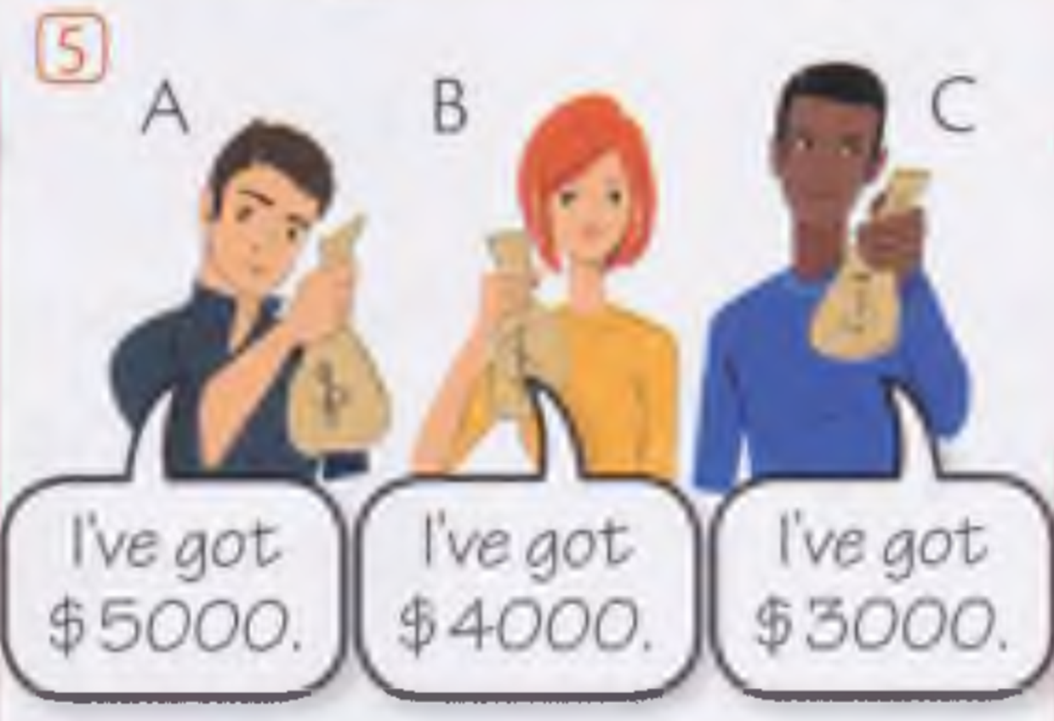

Slide 30
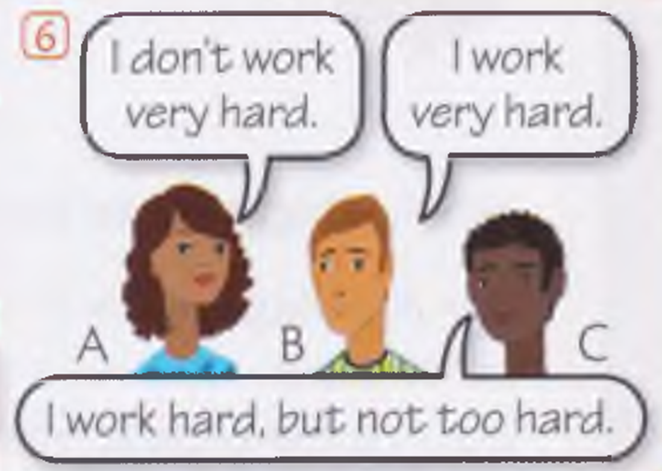

Slide 31
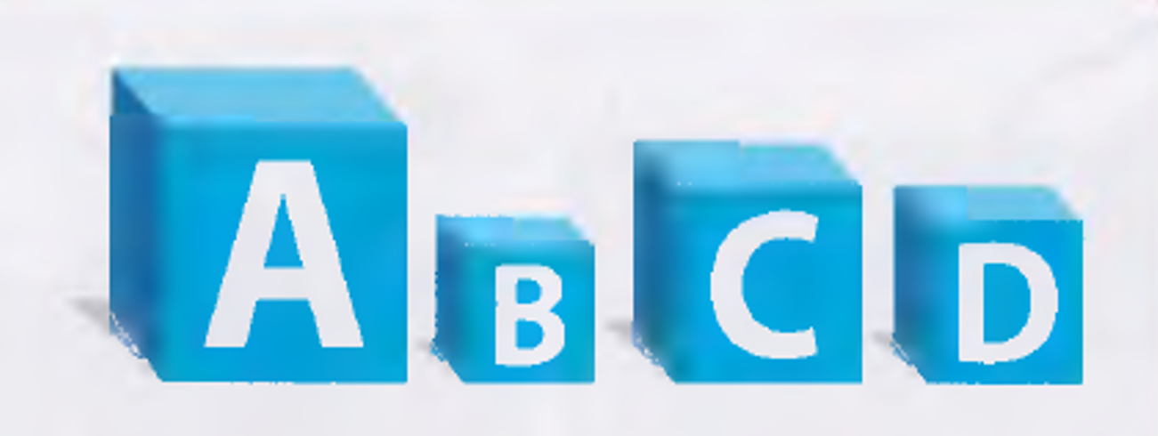

Slide 32
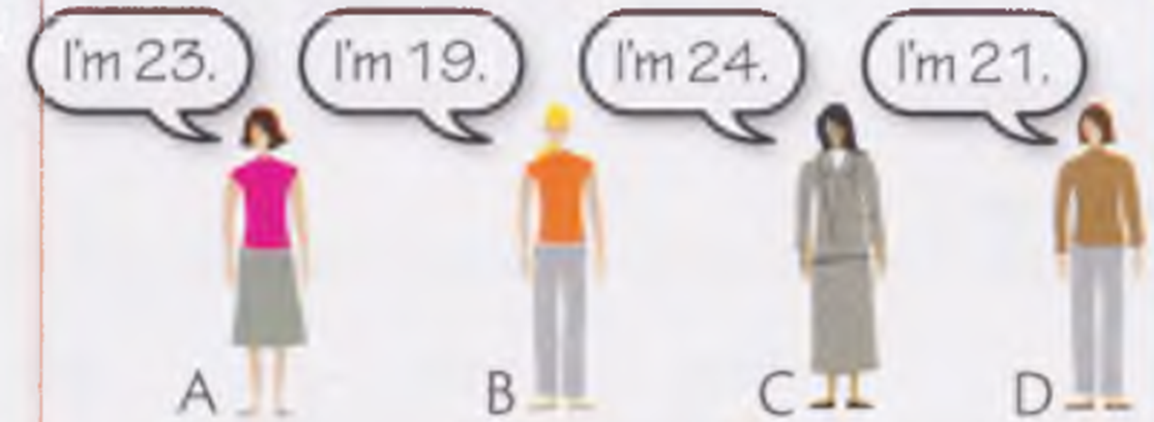

Slide 33
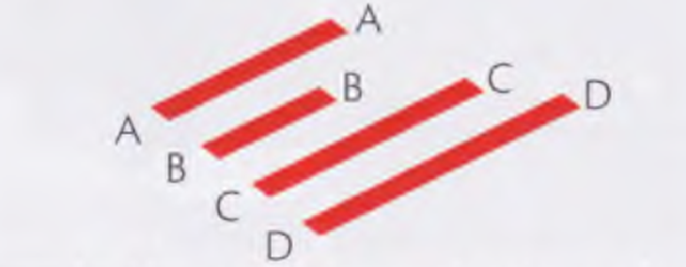

Slide 34
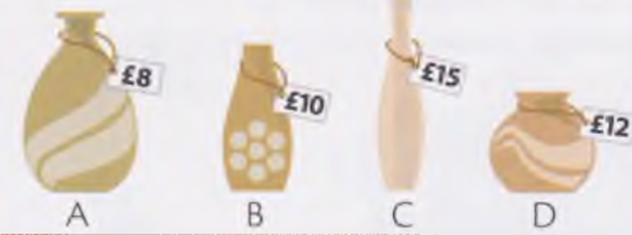

Slide 35
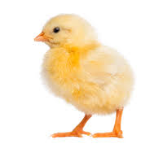
LITTLE – LESS –THE LEAST

Slide 36
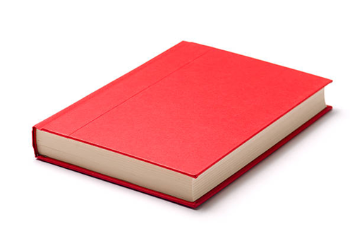
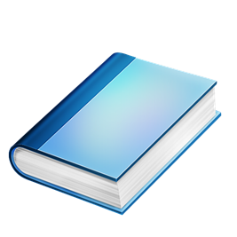
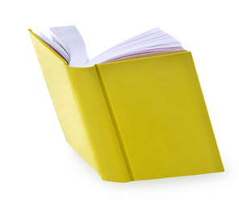
interesting
blue / yellow
The blue book is less interesting than the yellow one.
red
The red book is the least interesting of all.

Slide 37
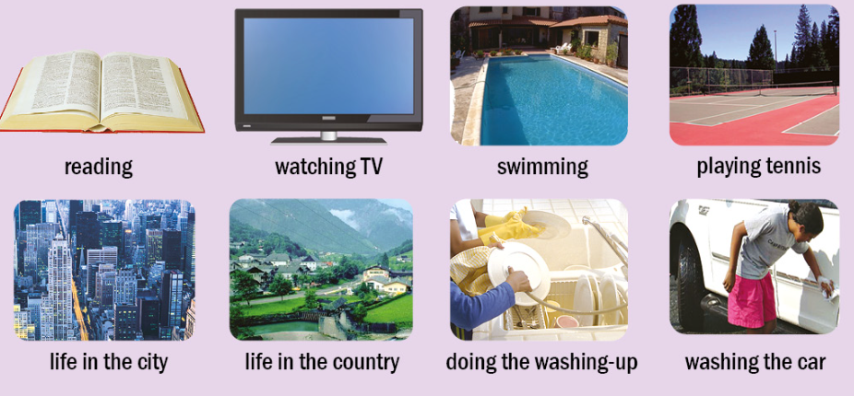
Compare the activities using: easy, difficult, exciting, interesting, boring, bad, good, safe, dangerous

Slide 38
Adjective | Comparative | Superlative
small | smaller | the smallest
big | bigger | the biggest
fat | fatter | the fattest
easy | easier | the easiest
funny | funnier | the funniest
modern | more modern | the most modern
important | more important | the most important
good | better | the best
bad | worse | the worst
little | less | the least
far | farther/further | the farthest/the furthest
many/much | more | the most

Slide 39
Source of the images:
https://www.google.com/
Raymond Murhpy: Essential Grammar in Use, Cambridge University Press 2015.
Mitchell-Malkogianni: Full Blast Plus 2, MMPublications 2019.
LAST DOWNLOAD: 2026.06.03.

